Slide 1
Investigating the State-of-the-Art of Differential Privacy in Natural Language Processing
23.10.2023, Bachelor’s Thesis Final Presentation
Natalia Milanova

Slide 2
Outline
Motivation
  Introduction
  Problem Statement and Motivation
  Research Questions and Methodology
  Literature Review
  Semi-structured Interviews
  Results
  Conclusion
  Limitations
  Future Work

Slide 3
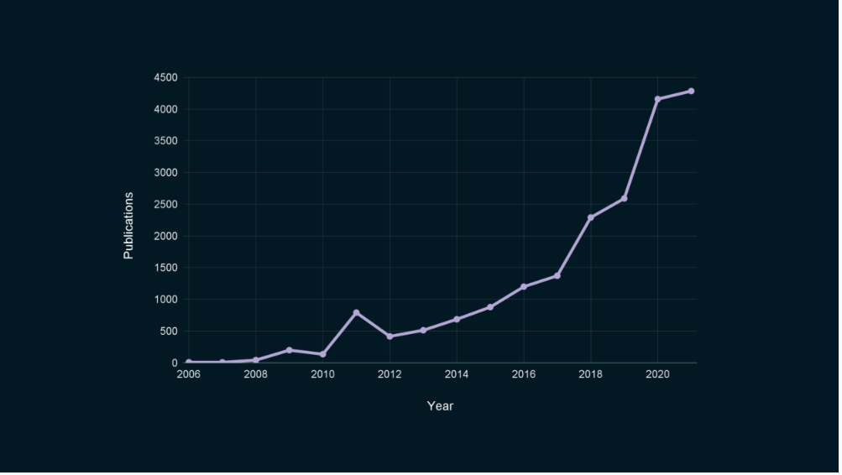
Motivation
“Differential privacy has become a de facto standard” [2]
The number of academic papers related to differential privacy over time [3]:

Slide 4
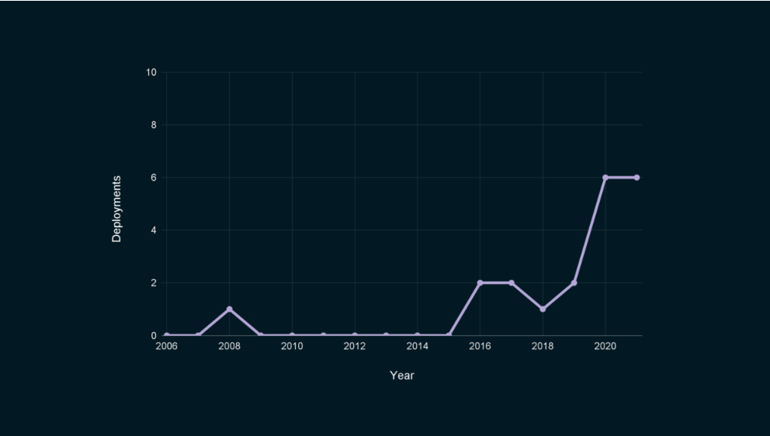
Motivation
Differential Privacy Deployments: still a small number of deployments [3]:
[4]:image2

Slide 5
Problem statement
What is covered by academic literature
Founded Research Gap and Aim
Relevant concepts of differential privacy are easily provided through literature and platforms [5]
Focus on differentially private algorithms and diverse differentially private relaxations [6]
Typical mistakes and proposed counterexamples [7]
Focus on recommendations on how to choose the right epsilon value [8]
No straightforward connection between DP and DP in NLP [9]
Limited work regarding practical application of differential privacy in NLP
There do not exist any guidance on choosing differential privacy at all
Research gap: what are the requirements to implement differential privacy
Aim: motivate practitioners to apply differential privacy in NLP and broaden the applicability of differential privacy

Slide 6
Research Questions
Investigating the State-of-the-Art of Differential Privacy in Natural Language Processing
RQ1: What are the properties of Differential Privacy that define its practical application settings?
RQ2: How can these characteristics be mapped appropriately to Natural Language Processing use cases?
RQ3: What are the barriers to adoption for differential privacy in Natural Language Processing, and what success factors have been observed?
Literature Review
Literature Review
Semi-structured interviews

Slide 7
Research Methodology
Literature Review
Semi-structured Interviews
Design Literature Review Strategy
Databases:
  Google Scholar, Scopus, IEEE
Inclusion criteria
Exclusion criteria
~ 102 scientific papers
Search properties of Differential Privacy
Based on the results, determine how this properties can be mapped to NLP use cases appropriately
Foundation for the semi-structured interviews
Design interview based on the findings
Semi-structured Interviews with
Scientists drawn from the papers
Practitioners
Synthesis
Derive Research Results

Slide 8
Research Methodology
Literature Review
Semi-structured Interviews
Design Literature Review Strategy
Databases:
  Google Scholar, Scopus, IEEE
Inclusion criteria
Exclusion criteria
~ 102 scientific papers
Search properties of Differential Privacy
Based on the results, determine how this properties can be mapped to NLP use cases appropriately
Foundation for the semi-structured interviews
Design interview based on the findings
Semi-structured Interviews with
Scientists drawn from the papers
Practitioners
Synthesis
Derive Research Results

Slide 9
Research Methodology
Inclusion criteria
Exclusion criteria
Keywords derived from the research questions
  RQ1: What are the properties of Differential Privacy that define its practical application settings?
  RQ2: How can these characteristics be mapped appropriately to Natural Language Processing use cases?
Backwards snowballing
Papers published before 2006
Keywords not relevant for the research excluded
  Graph
  Image
  (Homomorphic) Encryption
  Federated learning
Papers not relevant for the research based on the title and abstract excluded

Slide 10
Research Methodology
Literature Review
Semi-structured Interviews
Design Literature Review Strategy
Databases:
  Google Scholar, Scopus, IEEE
Inclusion criteria
Exclusion criteria
~ 102 scientific papers
Search properties of Differential Privacy
Based on the results, determine how this properties can be mapped to NLP use cases appropriately
Foundation for the semi-structured interviews
Design interview based on the findings
Semi-structured Interviews with
Scientists drawn from the papers
Practitioners
Synthesis
Derive Research Results

Slide 11


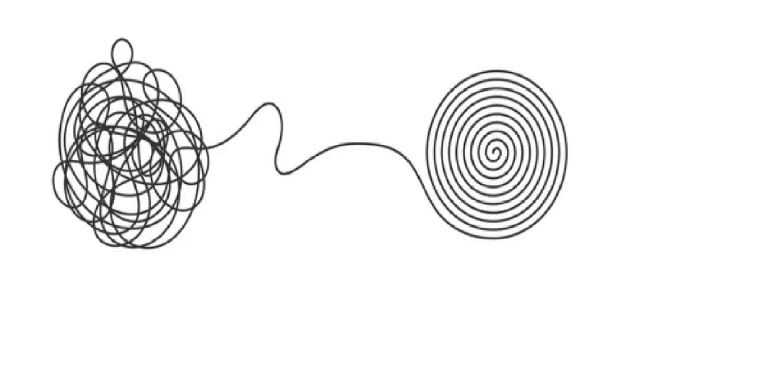
Research Methodology
Identify relevant scientific literature
Put the found characteristics in order
Define Keywords
Inspired by the work of Gallersdörfer and Matthes [13], who in order to find valid use cases searched for:
Requirements: mandatory features of Blockchain usage
Supporting characteristics: features of Blockchain that make it recommendable
We were also motivated to split the found characteristics into two categories:
Strict requirements: mandatory characteristics of differential privacy that make its use possible
Lenient requirements: additional characteristics of differential privacy that make the technology more suitable and might serve as guidance whether or not it is advisable to use differential privacy
[10]:image3
[11]:image4
[12]:image5

Slide 12
Research Methodology
Literature Review
Semi-structured Interviews
Design Literature Review Strategy
Databases:
  Google Scholar, Scopus, IEEE
Inclusion criteria
Exclusion criteria
~ 102 scientific papers
Search properties of Differential Privacy
Based on the results, determine how this properties can be mapped to NLP use cases appropriately
Foundation for the semi-structured interviews
Design interview based on the findings
Semi-structured Interviews with
Scientists drawn from the papers
Practitioners
Synthesis
Derive Research Results

Slide 13
Research Methodology
Selection Process
Interview partners were (co-)authors of the literature we used for the literature review
44 people were contacted in the period July 2023 – August 2023
Main Goal
Verification of results
Discussion about the current challenges and success factors of implementing DP in NLP
Insights into the practical viewpoint of our interview partners
Interview Questions
Background
  “What is your current position? How many years of experience with NLP and DP do you have, if any?”
Differential Privacy Requirements [Artifact Review]
  “Looking at standard Differential Privacy, do you agree with all of the requirements listed?”
Use Cases in NLP
  “Can you name any NLP use cases in which Differential Privacy would be applicable? Could you elaborate upon any challenges or difficulties you foresee here?”
Looking Beyond
  “What are the key areas of NLP research that require further exploration to incorporate differential privacy?”

Slide 14
Research Methodology
Interviewees and Interview Synopses
ID | Current position | Country | Experience in privacy | Experience in NLP | Experience in NLP and DP | Duration of the interview (h:mm:ss)
#1 | Postdoc | United States | 5 years | 3 years | 3 years | 0:52:03
#2 | Research Scientist | United States | 5 years | 3 years | 3 years | 0:31:19
#3 | Staff Research Scientist | United States | 9 years | none | none | 0:33:13
#4 | PhD Student | Singapore | - | - | 2 years | 0:45:02
#5 | Professor | Germany | 3 years | 10 years | 3 years | 0:42:57
#6 | staff research scientist | United States | 12 years | 7 years | 6 years | 0:49:42

Slide 15
Research Methodology
Literature Review
Semi-structured Interviews
Design Literature Review Strategy
Databases:
  Google Scholar, Scopus, IEEE
Inclusion criteria
Exclusion criteria
~ 102 scientific papers
Search properties of Differential Privacy
Based on the results, determine how this properties can be mapped to NLP use cases appropriately
Foundation for the semi-structured interviews
Design interview based on the findings
Semi-structured Interviews with
Scientists drawn from the papers
Practitioners
Synthesis
Derive Research Results

Slide 16
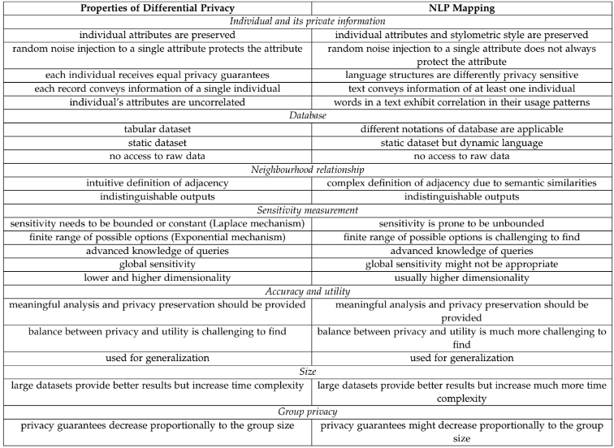
Results
RQ1 and RQ2 – Strict and Lenient Requirements

Slide 17
Results
RQ1 and RQ2 – Strict Requirements
Individual and Private Data
required, otherwise it does not make sense to use Differential Privacy
we explored different characteristics of individual and private data in original Differential Privacy and in Differential Privacy in NLP context
Requirement | Properties of Differential Privacy | NLP Mapping
individual and private data | individual attributes are preserved | individual attributes and stylometric style are preserved
 | random noise injection to a single attribute protects the attribute | random noise injection to a single attribute does not always protect the attribute
equal privacy guarantees | each individual receives equal privacy guarantees | language structures are differently privacy sensitive
individual data records | each record conveys information about a single individual | text conveys information about at least one individual
independence between attributes | individual's attributes are uncorrelated | words in a text exhibit correlation in their usage patterns

Slide 18
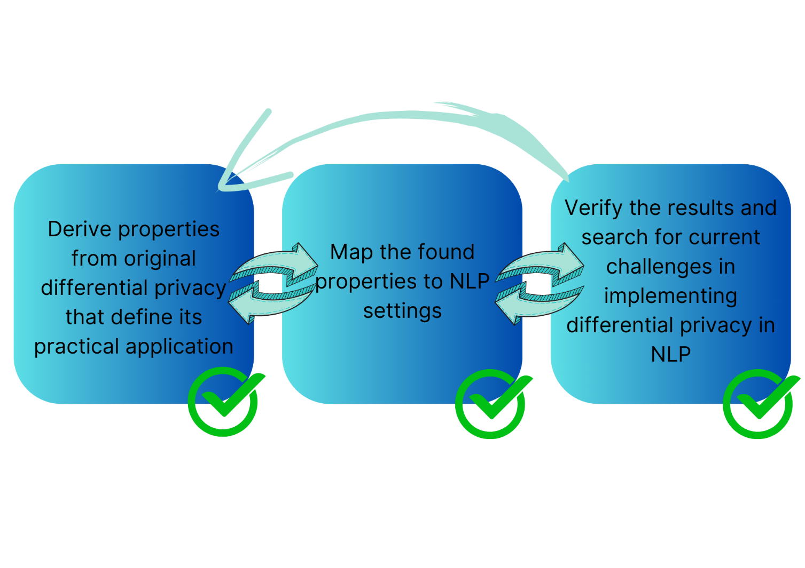
Overview of the research process and findings
“What does it mean to protect individuals in the data sets? Are you protecting just authors? Are you protecting the people whose data is being discussed in the text? I don't know the answer to that. This seems like one of the major questions that I would have if I was to look at a use case. ”[#3]
Textual data might identify more than one person: the writer and the described person
One record, one individual

Slide 19
Results
RQ1 and RQ2 – Strict Requirements
Adjacent Databases
requirement coming from the definition of Differential Privacy
we compared how the definition differs between original Differential Privacy and Differential Privacy in NLP
Requirement | Properties of Differential Privacy | NLP Mapping
database availability | tabular dataset | different notations of database are applicable
 | static dataset | static dataset but dynamic language
no access to raw data | no access to raw data | no access to raw data
adjacency definition | intuitive definition of adjacency | complex definition of adjacency
indistinguishable outputs | indistinguishable outputs | indistinguishable outputs

Slide 20
Overview of the research process and findings
Adjacent databases differ by a single row
Adjacent databases might differ by n consecutive words or by a single user

Slide 21
Overview of the research process and findings
“If we want to apply DP properly, we want to try to protect individuals. So we want to protect users and participants in these types of datasets. So protecting tokens or examples and documents and paragraphs doesn't seem to hit the right spot” [#6]
“Adjacent databases differ by a unit of x. What is this unit x? This is very much an application-dependent unit.” [#6]
“Well, it depends on the use case, right? That captures what you want to protect.” [#3]

Slide 22
Results
RQ1 and RQ2 – Strict Requirements
Correct Sensitivity Measurement
many algorithms are falsely declared to be differentially private due to miscalculated sensitivity
we looked at what is required for sensitivity measurement
Requirement | Properties of Differential Privacy | NLP Mapping
bounded sensitivity | sensitivity needs to be bounded or constant (Laplace mechanism) | sensitivity is prone to be unbounded
 | finite range of possible options (Exponential mechanism) | finite range of possible options is challenging to find
advanced knowledge of queries | advanced knowledge of queries | advanced knowledge of queries
sensitivity type | global sensitivity | global sensitivity might not be appropriate

Slide 23
Overview of the research process and findings
“This is a very, very common pattern in differential privacy. You start out with a question that has unbounded sensitivity and then you bound it sort of manually”[#3]
Sensitivity needs to be bounded
In NLP, sensitivity is prone to be unbounded

Slide 24
Results
RQ1 and RQ2 – Strict Requirements
Accuracy and Utility
being unable to analyze the data would not correspond to the main ideas of Differential Privacy
Property | Properties of Differential Privacy | NLP Mapping
balance between utility and privacy | meaningful analysis and privacy preservation should be provided | meaningful analysis and privacy preservation should be provided
 | balance between privacy and utility is challenging to find | balance between privacy and utility is much more challenging to find
general scope of analysis | used for generalization | used for generalization

Slide 25
Results
RQ1 and RQ2 – Lenient Requirements
Diverse and Large Database
we searched for additional characteristics of Differential Privacy that:
  are not mandatory
  improve utility or not impair privacy protections
Requirement | Properties of Differential Privacy | NLP Mapping
large dataset | large datasets provide better results but increase time complexity | large datasets provide better results but increase much more time complexity
diverse dataset | privacy guarantees decrease proportionally to the group size | privacy guarantees might decrease proportionally to the group size

Slide 26
Results
RQ2 – NLP Use Cases
Use cases coming from DP that are transferable to NLP
Use cases coming from NLP where DP can be implemented
Release publicly:
  data
  model parameters
Protect private data
Hinder memorization
Protect data during training
Protect data during model inference

Slide 27
Results
RQ2 – NLP Use Cases
“You could take differential privacy and apply it to another form of data by just really finding what a record means and what is a neighboring relation” [#3]
Use DP for NLP tasks
Semantic and Syntactic Analysis | Information Extraction | Machine Translation | Sentiment Analysis | Interactive Systems
Text data might describe person A but be contributed by person B | Text data might describe person A but be contributed by person B | Text data might describe person A but be contributed by person B | Text data might describe person A but be contributed by person B | Text data might describe person A but be contributed by person B | Individual | DP Requirement
No guarantee how a word will be perturbed | Some patterns might still identify the individual | Idioms do not allow word per word translation | Different ways to express emotions | Word- and individual-level DP are not suitable due to references by other participants | Data Protection
 | Single or multi- document input | Each data point might be differently sensitive |  | Collection of individual contributions might not be enough | Database

Slide 28
Results
RQ3 - Challenges
Lack of transparency and reproducibility:
“What should you take to get into that [differential privacy] and get really familiar to the depth of everything? And then you run into issues” [#5]
Utility measurement
“When it comes to assessing privacy-utility trade-offs, note that sometimes there do not exist non-DP utility baselines to compare against” [14] [#6]
Machines are still unable to understand how similar two texts are as we as humans are
“Sometimes cosine similarity will miss things like the “NOT” case, because sometimes synonyms and antonyms are ranked very similar because they're related” [#4]
Private data identification and processing:
“It’s an arbitrary decision” [#5] how private and sensitive data are defined
Data collection
“But for the pre-trained models, for those big models, the GPT models - those are trained on web data. And those data sets are mostly, for the most part, publicly available for everybody to look at and inspect. So there's not a whole lot of danger in leaking sensitive information in those models. When we talk about NLP plus DP, we need to be very aware of the fact, that it only kicks in in full gears when we start touching user data.” [#6]

Slide 29



Results
RQ3 – Success factors
Success stories
Apple
Personal assistant
Quick Type Suggestion
Google
Gboard
Smart compose
On-the-Fly rescoring
Smart text selection
Microsoft
DP N-gram extraction
Reply generation in Office
Main takeaways
All 3 companies collect a large amount of data and use user-level differential privacy
Apple (Quick Type Suggestion) and Google (Gboard) limit the number of contributions per individual
Microsoft(DP N-gram extraction) use a collection of Reddit posts as a database

Slide 30
A Recap, Limitations, and Future Trajectories
Summary
We defined properties of Differential Privacy
We saw how these properties apply to NLP use cases
We identified the current challenges and success factors
Limitations
The literature was predominately concentrated on textual data (not speech)
Limited number of interviews have been conducted
Future work
Differential Privacy in NLP under another granularity or under another approaches such as text rewriting
Standard what privacy means and how to measure it
DP and language models
Collocations and dialects
Small and medium-sized companies
Other privacy-enhancing technology that is “better suited for language” [#1]

Slide 31
Thank you for your attention!
Do you have any questions?

Slide 32
Natalia Milanova
17132
matthes@in.tum.de

Slide 33
References
[1] image1: Devaux, E. (Dec. 2022). What is Differential Privacy: definition, mechanisms, and examples. url: https://www.statice.ai/post/what-is-differential-privacy-definition-mechanisms-examples
[2]: Ding, Z., Wang, Y., Wang, G., Zhang, D., & Kifer, D. (2018). Detecting Violations of Differential Privacy. Proceedings of the 2018 ACM SIGSAC Conference on Computer and Communications Security, 475–489. https://doi.org/10.1145/3243734.3243818
[3]: Desfontaines, D. (Mar. 2022). A bottom-up approach to making differential privacy ubiquitous. url: https://desfontain.es/privacy/bottom-up-differential-privacy.html
[4]: image2: Panetta K.,5 Trends Drive the Gartner Hype Cycle for Emerging Technologies, 2020 https://www.gartner.com/smarterwithgartner/5-trends-drive-the-gartner-hype-cycle-for-emerging-technologies-2020
[5]: Wood, A., M. Altman, A. Bembenek, M. Bun, M. Gaboardi, J. Honaker, K. Nissim, D. O’Brien,
T. Steinke, and S. Vadhan (2018a). “Differential Privacy: A Primer for a Non-Technical
Audience”. en. In: SSRN Electronic Journal. issn: 1556-5068. doi: 10.2139/ssrn.3338027.
url: https://www.ssrn.com/abstract=3338027 (visited on 05/24/2023)
[6]: Desfontaines, D. and B. Pejó (Nov. 2022). SoK: Differential Privacies. arXiv:1906.01337 [cs]. url:
http://arxiv.org/abs/1906.01337 (visited on 05/27/2023)
[7]: Ding, Z., Y. Wang, G. Wang, D. Zhang, and D. Kifer (Oct. 2018). “Detecting Violations of
Differential Privacy”. en. In: Proceedings of the 2018 ACM SIGSAC Conference on Computer and Communications Security. Toronto Canada: ACM, pp. 475–489. isbn: 978-1-4503-5693-0. doi:
10.1145/3243734.3243818. url: https://dl.acm.org/doi/10.1145/3243734.3243818
(visited on 05/24/2023)

Slide 34
References
[8]: Dwork, C., N. Kohli, and D. Mulligan (2019). “Differential privacy in practice: Expose your
epsilons!” In: Journal of Privacy and Confidentiality 9.2
[9]: Klymenko, O., Meisenbacher, S., and Matthes, F. (2022). “Differential Privacy in Natural Language Processing The Story So Far”
[10]: image3: blossomstar. “Keywording, SEO keywording process, keyword research, keywords optimization flat vector illustration design. Design for web banners and apps”, https://www.shutterstock.com/image-vector/keywording-seo-process-keyword-research-keywords-717141007
[11]: image4: Dan Golden, July 6, 2020, “Keyword Intent: Why It Matters for SEO & How to Do It Right”
[12]: image5: Mironov Konstantin, “Chaos and order business concept flat style design vector illustration isolated on white background. Tangled disorder turns into spiral order line, find solution. Coaching, mentoring or psychotherapy.”
[13]: U. Gallersdörfer and F. Matthes, "Towards Valid Use Cases: Requirements and Supporting Characteristics of Proper Blockchain Applications," 2020 Seventh International Conference on Software Defined Systems (SDS), Paris, France, 2020, pp. 202-207, doi: 10.1109/SDS49854.2020.9143999.
[14]: Cummings, R., Desfontaines, D., Evans, D., Geambasu, R. Jagielski, M., Huang, Y.,…Zhang, W. (2023). “Challenges towards the Next Frontier in Privacy”

Slide 35
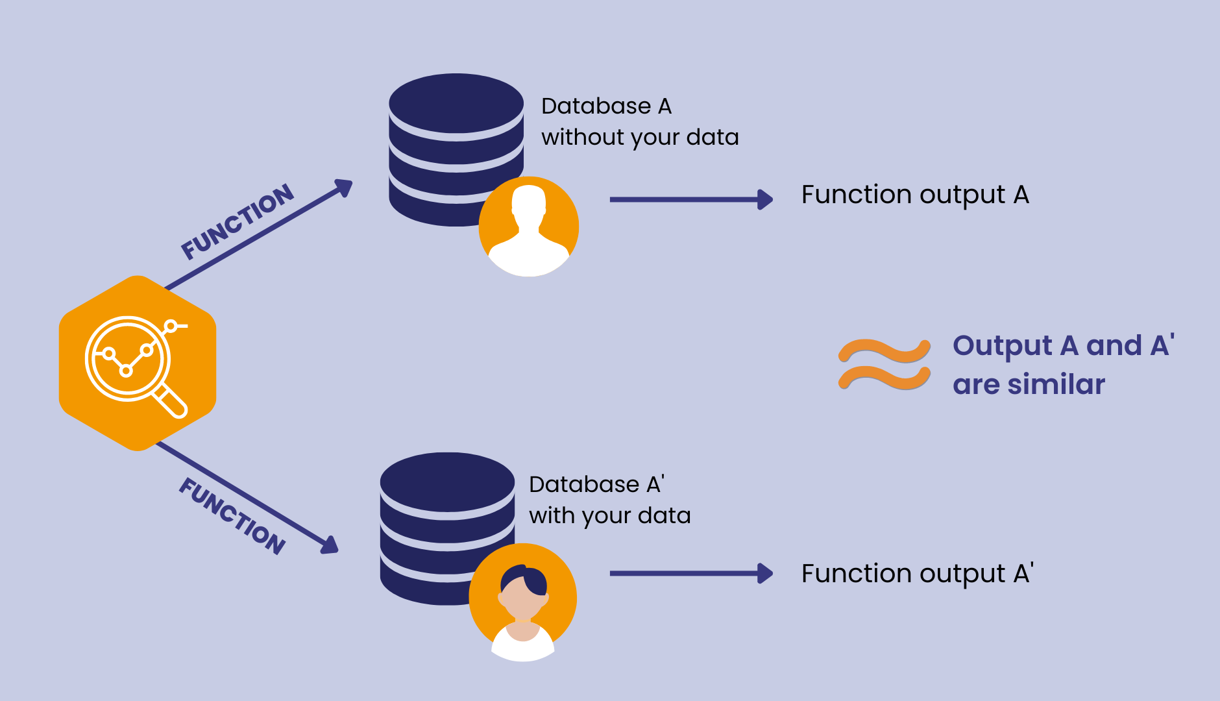
Definition
Differential Privacy
[1]:image1

Slide 36
Research Methodology
Selecting academic literature
Search strings | IEEE Xplore | Scopus | Google Scholar
"differential privacy" AND "nlp" | 268 | 32 | 2520
(properties OR characteristics OR features OR guarantees) AND "differential privacy" AND "nlp" | 253 | 16 | 2380
(properties OR characteristics OR features OR guarantees) AND "differential privacy" AND "nlp" AND NOT (graph OR image OR tree OR encryption OR "federated learning") | 13 | 11 | 144
(properties OR characteristics OR features OR guarantees) AND "differential privacy" AND "use case" AND NOT (graph OR image OR tree OR encryption OR "federated learning") | 66 | 9 | 337
"differential privacy" AND "nlp" AND "nlp applications" | 4 | 3 | 188
"differential privacy" AND "nlp" AND "use case" | 57 | 2 | 489

Slide 37
Research Methodology
Selecting academic literature
Search strings | IEEE Xplore | Scopus | Google Scholar
"differential privacy" AND "nlp" | 268 | 32 | 2520
(properties OR characteristics OR features OR guarantees) AND "differential privacy" AND "nlp" | 253 | 16 | 2380
(properties OR characteristics OR features OR guarantees) AND "differential privacy" AND "nlp" AND NOT (graph OR image OR tree OR encryption OR "federated learning") | 13 | 11 | 144
(properties OR characteristics OR features OR guarantees) AND "differential privacy" AND "use case" AND NOT (graph OR image OR tree OR encryption OR "federated learning") | 66 | 9 | 337
"differential privacy" AND "nlp" AND "nlp applications" | 4 | 3 | 188
"differential privacy" AND "nlp" AND "use case" | 57 | 2 | 489

Slide 38
Research Methodology
Selecting academic literature
Search strings | IEEE Xplore | Scopus | Google Scholar
"differential privacy" AND "nlp" | 268 | 32 | 2520
(properties OR characteristics OR features OR guarantees) AND "differential privacy" AND "nlp" | 253 | 16 | 2380
(properties OR characteristics OR features OR guarantees) AND "differential privacy" AND "nlp" AND NOT (graph OR image OR tree OR encryption OR "federated learning") | 13 | 11 | 144
(properties OR characteristics OR features OR guarantees) AND "differential privacy" AND "use case" AND NOT (graph OR image OR tree OR encryption OR "federated learning") | 66 | 9 | 337
"differential privacy" AND "nlp" AND "nlp applications" | 4 | 3 | 188
"differential privacy" AND "nlp" AND "use case" | 57 | 2 | 489

Slide 39
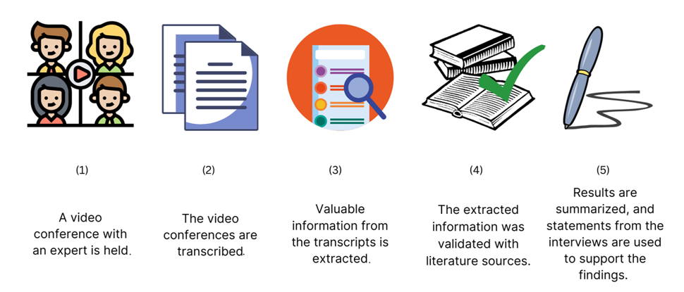
Research Methodology
Interview Process

Slide 40
Interview Questions
Background
What is your current position?
How many years of experience with NLP do you have, if any?
How familiar are you with Differential Privacy?
Differential Privacy Requirements [Artifact Review]
Looking at standard Differential Privacy, do you agree with all of the requirements listed?
Are there any requirements missing?
Now looking at the NLP side: does the mapping from standard requirements make sense?
Are there any changes that should be made?
Use Cases in NLP
Can you name any NLP use cases in which Differential Privacy would be applicable? What makes Differential Privacy suitable?
Could you elaborate upon any challenges or difficulties you foresee here?
Could you discuss any potential limitations or risks of using Differential Privacy in NLP?
Are there any technical challenges to be expected?
From an implementation standpoint, what are the key considerations for organizations looking to deploy differentially private NLP systems? Are there any requirements or best practices?
How can one evaluate privacy in NLP systems that employ Differential Privacy mechanisms?
Can you share any real-world examples or case studies where differential privacy has been successfully implemented in NLP applications? What were the lessons learned from those experiences?

Slide 41
Interview Questions
Looking Beyond
How do you see the current landscape of privacy regulations and standards affecting the implementation of differential privacy in NLP?
In your experience, do you find that tools and educational materials for explaining Differential Privacy are used in practice to facilitate the understanding to non-technical audiences?
What are the key areas of NLP research that require further exploration to incorporate differential privacy?
Generally speaking, what are the future prospects and challenges for implementing differential privacy in NLP? How do you envision the field evolving in the coming years?
Is there any aspect that might have been missed that should be discussed?
Can you recommend anyone else who may contribute to this interview study?

